Slide 1
‘Future of Work and the Impact on Human Capital’ Angelina Pillai National Manager, Professional Development Australian Human Resources Institute

Slide 2
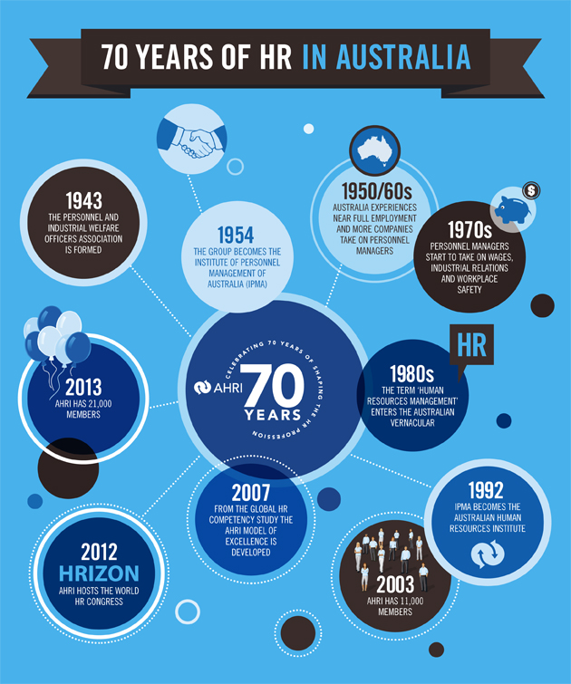
AHRI – 73 years and counting

Slide 3
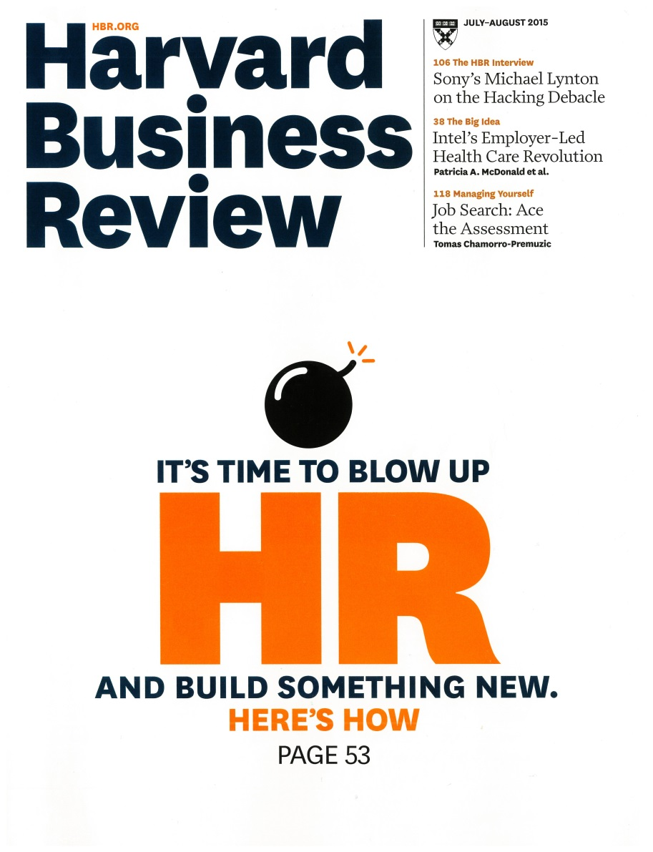

Slide 4
“CEOs know that they depend on their companies’ human resources to achieve success. Businesses don’t create value...people do.”
Ram Charan, Dominic Barton, Denis Carey Harvard Business Review, July-August Edition 2015

Slide 5
“Research by McKinsey and the Conference Board consistently finds that CEOs worldwide see human capital as a top challenge.”
Ram Charan, Dominic Barton, Denis Carey Harvard Business Review, July-August 2015

Slide 6
“Robots will be performing almost half of manufacturing tasks in a decade”
Bank of America
Merrill Lynch

Slide 7
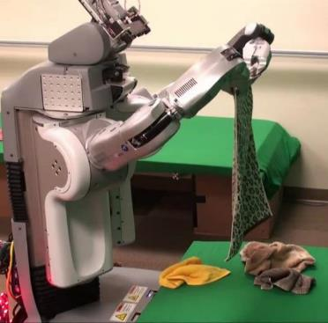
“Robots don’t kill jobs, people do”
Peter Cheese
CEO, CIPD

Slide 8
“To make sure that the future of work is human, and that we are designing workplaces that make the best of people.... not just the best of clever technology”
Peter Cheese
CEO, CIPD

Slide 9
Sully

Slide 10
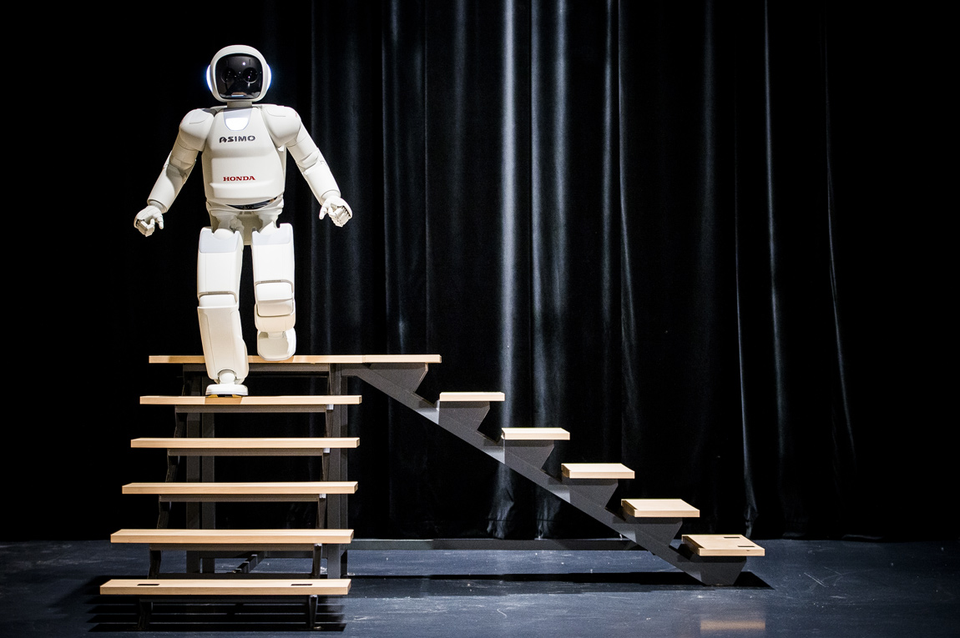
ASIMO

Slide 11
Kiva Robots

Slide 12
What is the fourth revolution?
1st revolution 1784
2nd revolution 1870
3rd revolution 1970
4th industrial revolution
Klaus Schwab, Chair WEF

Slide 13
Do they really do anything that improves productivity?

Slide 14
Technological Unemployment
When the more economic use of labour outruns the pace at which we find new uses for that displaced labour

Slide 15
People or Robots?

Slide 16
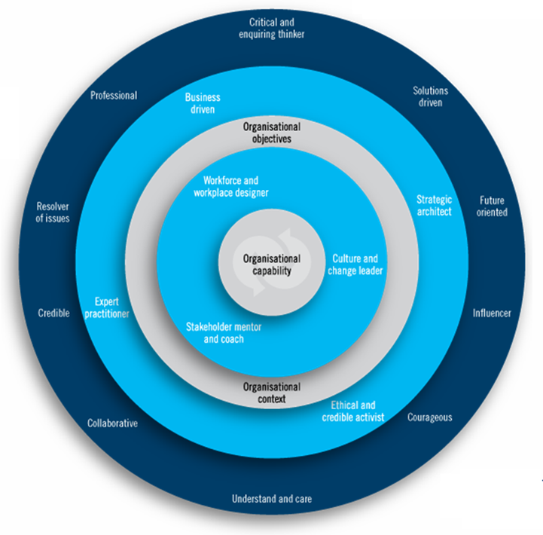
HR Certification
HR Certification in Australia

Slide 17
“CEOs know that they depend on their companies’ human resources to achieve success. Businesses don’t create value...people do.”
Ram Charan, Dominic Barton, Denis Carey Harvard Business Review, July-August Edition 2015

Slide 18
What does it mean for skills?

Slide 19
Top five “safe” occupations
Recreational therapists
First-line supervisors of mechanics, installers and repairers
Emergency management directors
Mental health and substance abuse social workers
Audiologists

Slide 20
Bottom five “unsafe” occupations
698. Insurance underwriters
699. Mathematical technicians
700. Hand sewers
701. Title examiners, abstractors and searchers
702. Telemarketers

Slide 21
Frey-Osborne Analysis
Recreational therapists
First-line supervisors of mechanics, installers and repairers
Emergency management directors
Mental health and substance abuse social workers
Audiologists
698. Insurance underwriters
699. Mathematical technicians
700. Hand sewers
701. Title examiners, abstractors and searchers
702. Telemarketers

Slide 22
Employable Attributes
Ability
Likeability
Drive
Dr. Tomas Chamorro–Premuzic

Slide 23
The challenge for HR
“to make the best of people ... not just the best of clever technology”

Slide 24
So, what does the future look like…?
STEM skills clearly important
But need to be doing skilled, not routine, work
People skills becoming more important
Growing opportunities to use technology to help people…
Working WITH technology essential
Key to greater productivity

Slide 25
So, what does the future look like…?
Lifelong learning is becoming increasingly important
New models of education delivery
Existing business models disrupted
Conglomerates replaced by networks?
Employees by freelancers?
Technology facilitates flexible working
Flexible careers

Slide 26
What does the future of work mean to you?
https://www.youtube.com/watch?v=dO5SKYF3iWE
Accenture UK
2015

